Slide 1


GM UNIVERSITY
Davanagere
PBL PRESENTATION ON
“HEALTHCARE PATIENT PORTAL”
Presented by,
Abhhishek M.P -
Adarsh D.S -
Alsamad H.M -
Chetan S.J -
U25E01AI002
U25E01AI003
U25E01AI009
U25E01AI031
Guide Ms. Kavya K N | PBL Coordinator Mr. Mohammad Zeeshan M | HOD Dr. Asha K
B.E, M.Tech
1

Slide 2

CONTENTS
1. Abstracts
2. Introduction
3. Problem statement
4. Objectives
5. Methodology
6. Software and hardware specifications

Slide 3
ABSTRACT
A Healthcare Patient Portal is a secure online platform for patients to acess and manage their personal health infconveniently. It serves as a digital bridge between patients and healthcareproviders, it allows patients to access their health records, test results,and appoitments anytime.
A Health Care Portal is an online platform that helps patients manage their health easily Through the portal, patients View their medical reports and prescriptions Book doctor appointments Check lab test results Communicate with doctors through messages or video calls Pay medical bills online Patients can view reports, prescriptions, and appointments easily.It saves time and reduces paperwork in hospitals.

Slide 4
INTRODUCTION
A Healthcare Portal is an Online platform that helps patients manage their health easily. Through the portal, patients can view their medical reports and prescriptions. They can also book doctor appointments and also check their lab test results. They can communicate with doctors through messages or video calls and able to pay medical bills online.
This project presents a secure, user-friendly digital platform designed to transform the way patients interact with healthcare services. The Healthcare Patient Portal empowers individuals to manage their health records, appointments, prescriptions, and provider communication—all from one centralized interface.

Slide 5
PROBLEM STATEMENT
In many healthcare systems, patients face difficulties in accessing their medical records, booking appointments, and communicating with healthcare providers. The absence of a centralized and user-friendly digital platform leads to delays, data errors, and poor patient engagement. Therefore, there is a need for a secure and efficient healthcare patient portal that provides easy access to personal health information and improves communication between patients and healthcare professionals.

Slide 6
OBJECTIVES
1. To provide patients with secure and convenient access to their personal health information.
2. To improve communication between patients and healthcare providers.
3. To allow online appointment scheduling, billing, and prescription refills.
4. To enhance patient engagement and participation in their own healthcare.
5. To reduce administrative workload and paperwork in hospitals or clinics.
6. To ensure accuracy, privacy, and timely updates of patient data.
7. To support better decision-making through access to electronic health records (EHR).

Slide 7
SOFTWARE REQUIREMENTS
HTML5 – Structure the voting interface
CSS3 – Style the layout with civic-themed visuals
JavaScript – Power vote logic and interactivity
Canva – Design banners, icons, and UI mockups
Visual Studio Code – Code editor for development
Live Server – Real-time preview while coding
Web Browser – Test and demo the simulation
Git & GitHub – Version control and project hosting

Slide 8
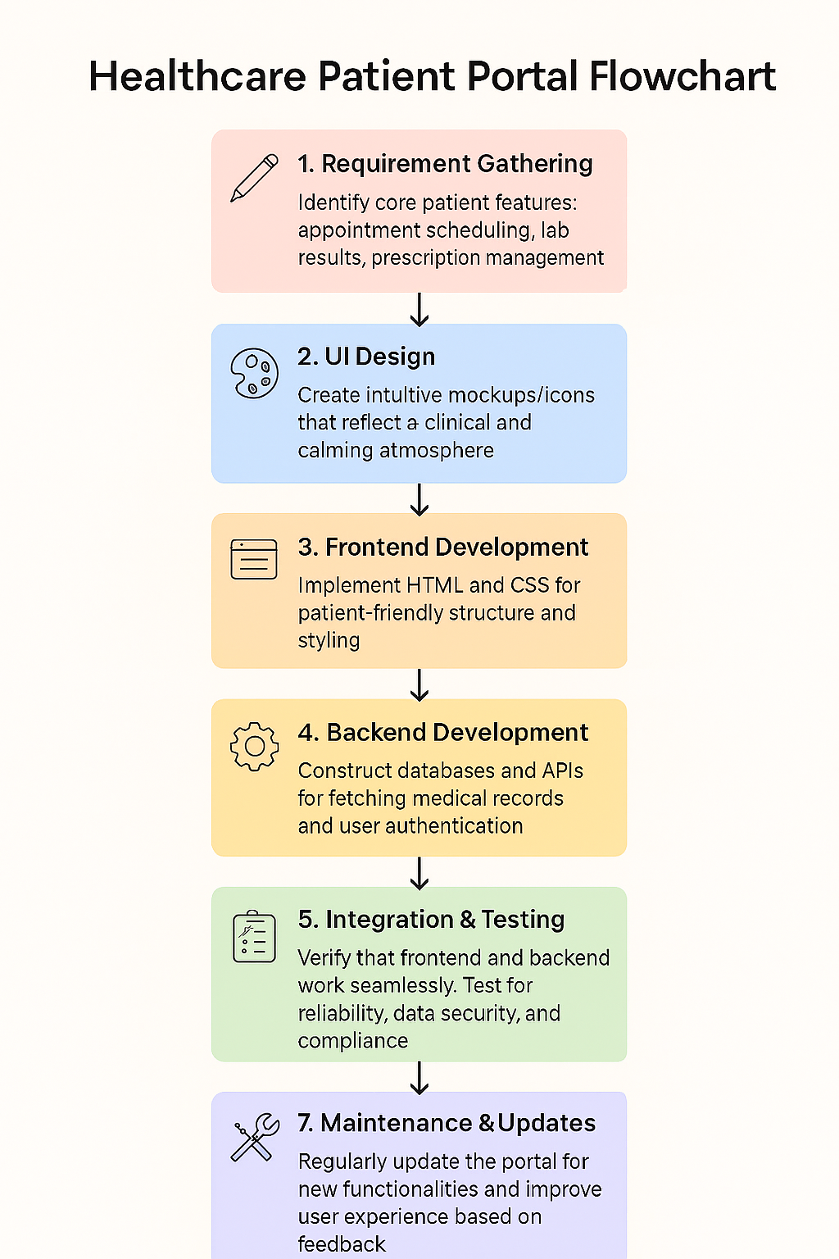
METHODOLOGY

Slide 9

Thank you all
12

